Slide 1
Reinforcement Learning Control
Name | SID
Rui XU | 56200188
Zhiyuan ZHANG | 56200176
Aleksa JELACA | 56158793

Slide 2
Background

Slide 3
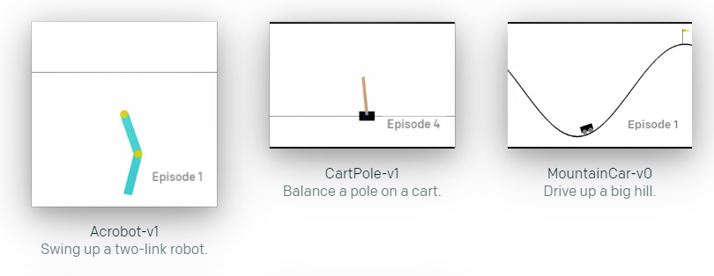
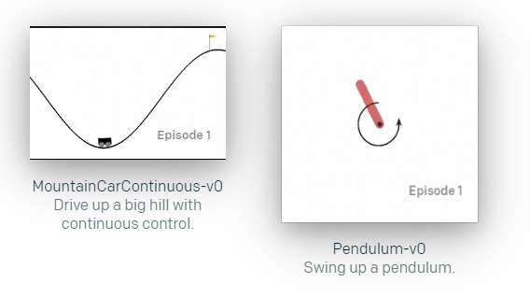
OpenAI gym and Algorithms
Q-Learning
Deep Q Network (DQN)
Discrete
Two paths
Actor Critic
Continuous
Deep Deterministic Policy Gradient (DDPG)

Slide 4
Methods

Slide 5
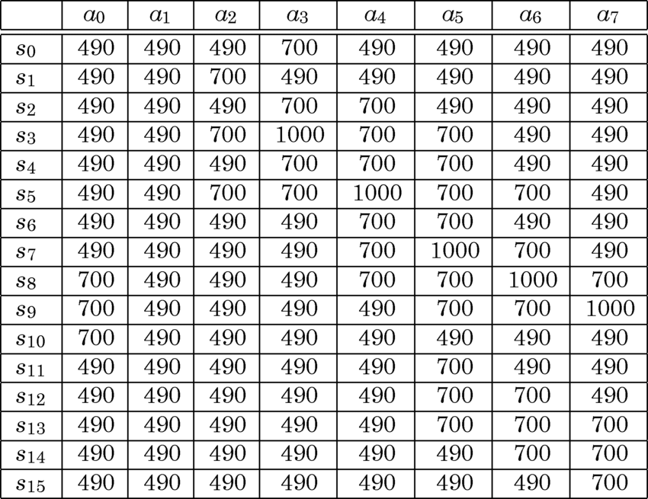
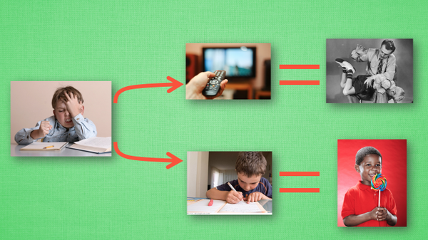
Q-Learning -> DQN
Q-Learning
Action
Reward
State
Can be represented by a Q-table

Slide 6
Q-Learning -> DQN
Q-Learning
Loss
Actual Q
Evaluated Q
α: learning rate
γ: decay factor
ε: probability to choose random action

Slide 7
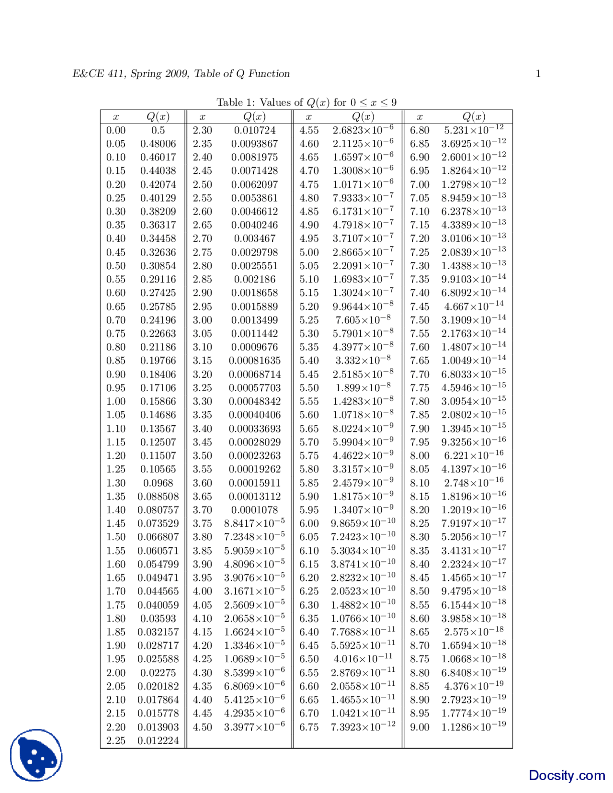
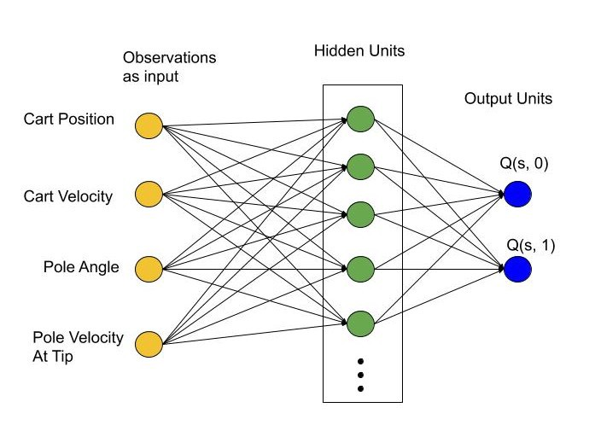
Q-Learning -> DQN
DQN
Deep neural network for function fitting
Too many states!

Slide 8
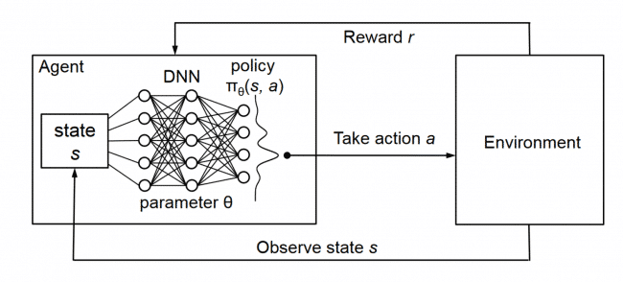
Q-Learning -> DQN
DQN

Slide 9
Q-Learning -> DQN
DQN
Problem 1: DL is the supervised learning that requires training set.
Solution: Labels are constructed using rewards through Q-learning.
Problem 2: In supervised learning, data is independent of each other.
Solution: Experience replay, for each updation, a portion of the data is extracted from Memory for the update
Problem 3: Every time the neural network is updated, the target will also be updated, which will easily lead to parameter non-convergence.
Solution: Q-targets is introduced. The Q network is updated every iteration, whereas the Target Q network is updated every once in a while.

Slide 10
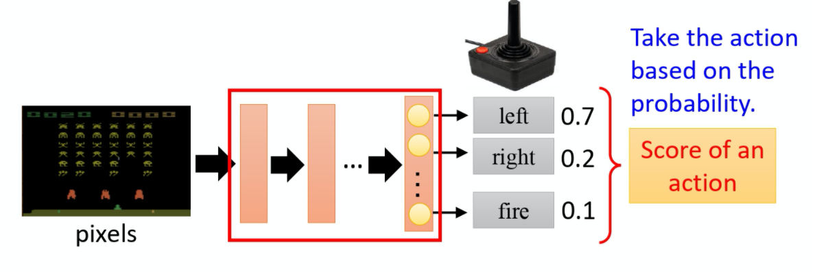
Policy Gradient -> Actor Critic -> DDPG
Policy Gradient
Input: the observation of the agent
policy

Slide 11
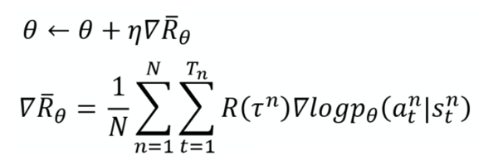

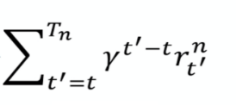
Policy Gradient
Discount reward
Log probability of action
Add Base line
Assign Suitable Credit

Slide 12
Problem of Policy Gradient
Problem 1: The network can only update its parameter after an episode.
Impact: Reduce the efficiency of the algorithm
Problem 2: It is difficult to decide the learning rate.
Impact: If the learning rate is too large, suffer from high variance. Otherwise, the training period is too long to wait.
Problem 3: On policy. Waste training examples
Impact: The data collected for updating can only be used once.

Slide 13
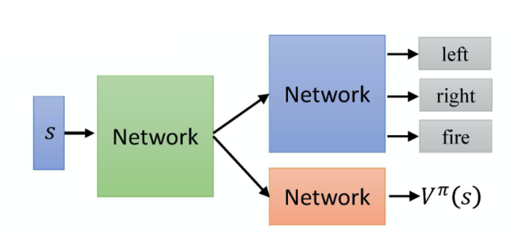
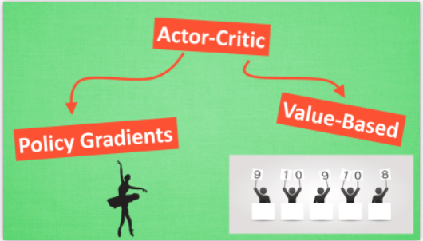
Policy Gradient -> AC
Combine policy gradient and DQN

Slide 14

Actor Critic
Modify the reward to Q-value

Slide 15
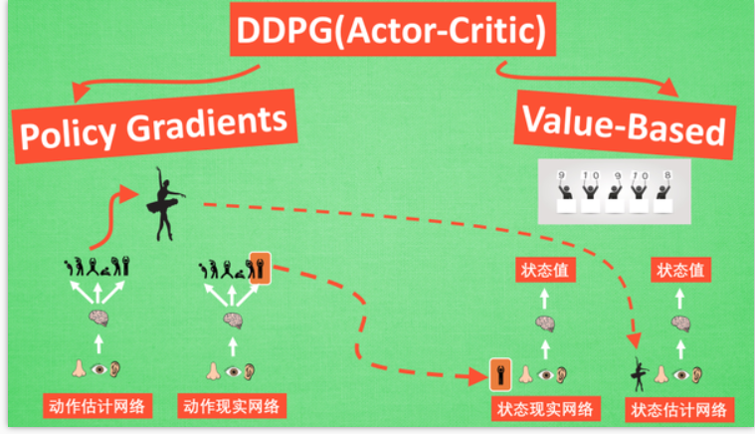
Actor Critic -> DDPG
state
state
Actor target
Actor
Q network
Q target network

Slide 16
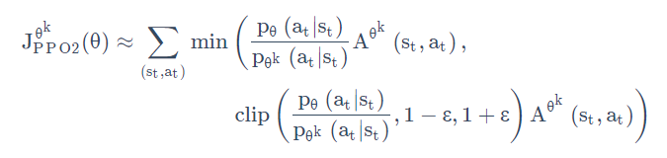
Future improvement: Actor Critic -> PPO
Recall the Problem 3: The data collected for updating can only be used once.

Slide 17
Experiment

Slide 18
Table result
Pair | First success episode 1 2 3 avg |  |  |  | Number of successes 1 2 3 avg |  |  |  | Total number of episodes | Success ratio 1 2 3 avg
Mountain Car | 5 | 3 | 3 | 3.67 | 88 | 87 | 91 | 88.67 | 100 | 88% | 87% | 91% | 88.67%
Acrobot | 2 | 2 | 1 | 1.67 | 98 | 91 | 98 | 95.67 | 100 | 98% | 91% | 98% | 95.67%
Cart Pole | 62 | 28 | 44 | 44.67 | 15 | 56 | 33 | 34.67 | 100 | 15% | 56% | 33% | 34.67%
Continuous Mountain Car | 22 | 24 | 23 | 23.00 | 78 | 74 | 74 | 75.33 | 100 | 78% | 74% | 74% | 75.33%
Pendulum | 29 | 32 | 30 | 30.33 | 56 | 55 | 56 | 55.67 | 100 | 56% | 55% | 56% | 55.67%

Slide 19
Observation and discussion
Different first episodes
Different success ratios
Influence of reward function on convergence in each algorithm
Suitability of reward function to each pair in each algorithm

